Slide 1
Mining Multidimensional Association Rules quantitative Rules
Multi-Level Rules
Constraint based Rules

Slide 2
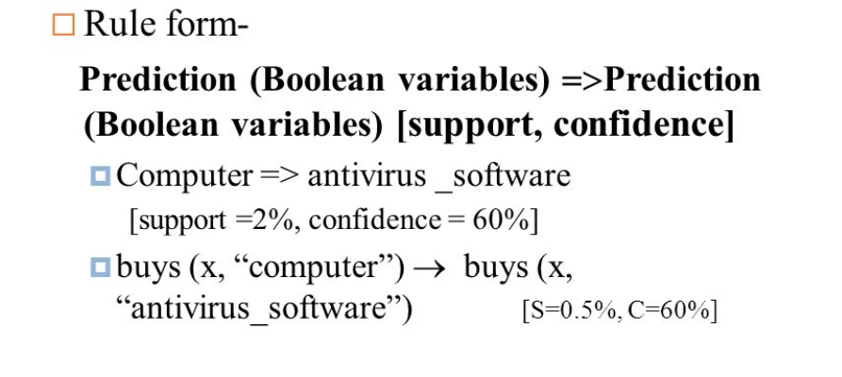

Slide 3
Mining Multidimensional Association Rules
Single dimensional or intradimensional association rule contains a single distinct predicate (e.g., buys) with multiple occurrences i.e., the predicate occurs more than once within the rule.

Slide 4
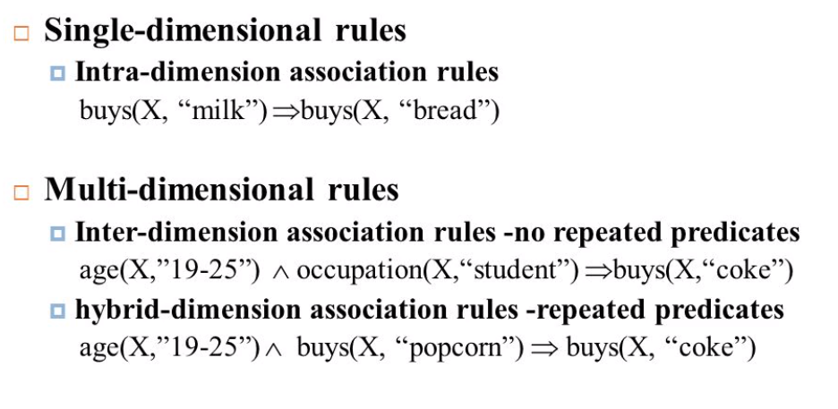

Slide 5
Mining Multidimensional Association Rules
Association rules that involve two or more dimensions or predicates can be referred to as multidimensional association rules.
age(X, “20…29”) ^ occupation(X, “student”)=>buys(X, “laptop”)
Rule contains three predicates (age, occupation, and buys), each of which occurs only once in the rule.
Multidimensional association rules with no repeated predicates are called inter-dimensional association rules.

Slide 6
Also mine multidimensional association rules with repeated predicates, which contain multiple occurrences of some predicates. These rules are called hybrid- dimensional association rules. An example of such a rule is the following, where the predicate buys is repeated:
age(X, ―20…29‖)^buys(X, ―laptop‖)=>buys(X, ―HP printer‖)

Slide 7
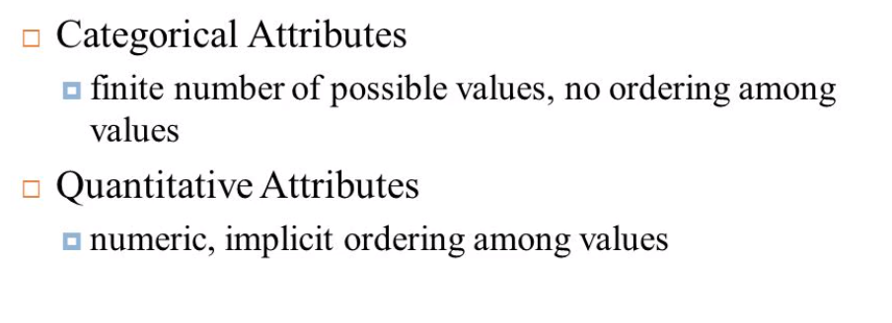
Multidimensional Association Rules

Slide 8
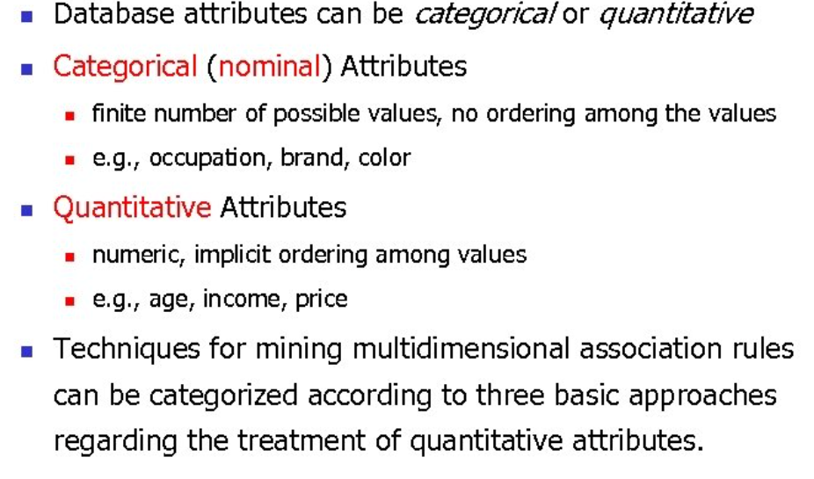

Slide 9
Mining Quantitative Association Rules
Quantitative association rules are multidimensional association rules in which the numeric attributes are dynamically discretized during the mining process so as to satisfy some mining criteria, such as maximizing the confidence or compactness of the rules mined.
we focus specifically on how to mine quantitative association rules having two quantitative attributes on the left-hand side of the rule and one categorical attribute on the right-hand side of the rule. That is
    quantitative attributes ^ quantitative attributes => categorical attribute
Such rules have been referred to as two-dimensional quantitative association rules, because they contain two quantitative dimensions.

Slide 10
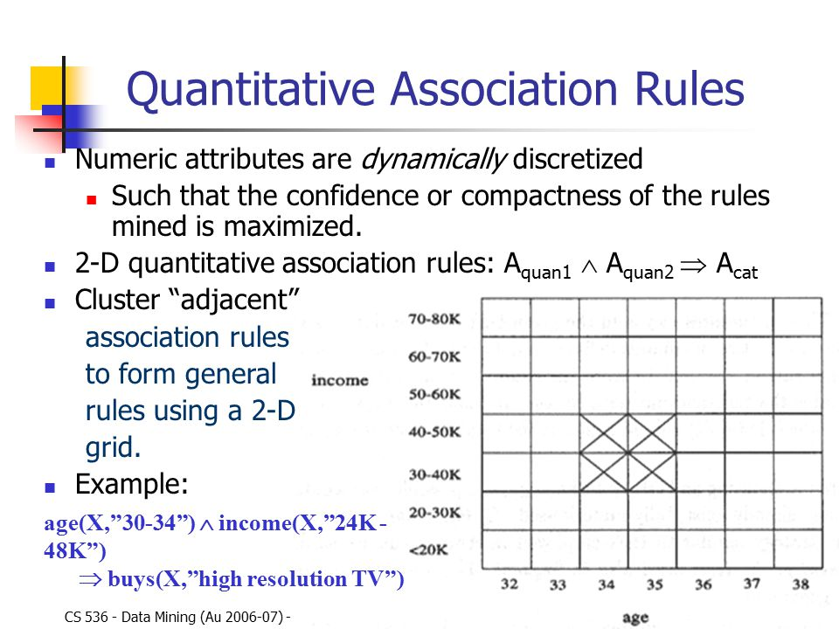

Slide 11


Slide 12
CONSTRAINT BASED ASSOCIATION RULES
A data mining process may uncover thousands of rules from a given set of data, most of which end up being unrelated or uninteresting to the users.
Users have a good sense of which “direction” of mining may lead to interesting patterns and the “form” of the patterns or rules they would like to find.
A good heuristic is to have the users specify such intuition or expectations as constraints to confine the search space.
This strategy is known as constraint-based mining.
Constraint based mining provides
  User Flexibility: provides constraints on what to be mined.
  System Optimization: explores constraints to help efficient mining.

Slide 13
Constraints can be of the following types
Knowledge type
Data Constraint
Dimension and level constraint
Interestingness constraint
Rule constraints

Slide 14
CONSTRAINT BASED ASSOCIATION RULES
In order to make the mining process more efficient rule based constraint mining :
Allows users to describe the rules that they would like to uncover.
Provides a sophisticated mining query optimizer that can be used to exploit the constraints specified by the user.
Encourages interactive exploratory mining and analysis.

Slide 15
CONSTRAINT BASED ASSOCIATION RULES
The constraints can include the following:
Knowledge type constraints: These specify the type of knowledge to be mined, such as association or correlation.
Data constraints: These specify the set of task-relevant data.
  Dimension/level constraints: These specify the desired dimensions (or attributes) of the data, or levels of the concept hierarchies, to be used in mining.

Slide 16
CONSTRAINT BASED ASSOCIATION RULES
Interestingness constraints: These specify thresholds on statistical measures of rule interestingness, such as support, confidence, and correlation.
  Rule constraints: These specify the form of rules to be mined. Such constraints may be expressed as rule templates, as the maximum or minimum number of predicates that can occur in the rule antecedent or consequent, or as relationships among attributes, attribute values, and/or aggregates. The above constraints can be specified using a high-level declarative data mining query language and user interface.

Slide 17
Multi level association rule
Association rules generated from mining data at multiple levels of abstraction are called multiple-level or multilevel association rules.
Multilevel association rules can be mined efficiently using concept hierarchies under a support-confidence framework.
Rules at high concept level may add to common sense while rules at low concept level may not be useful always.

Slide 18
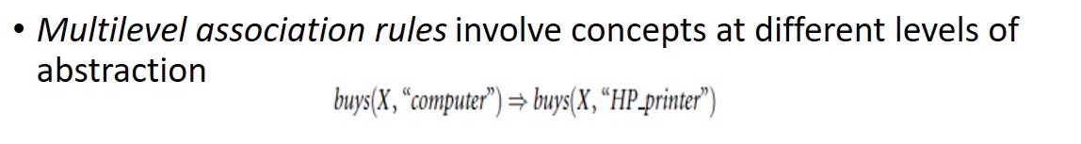
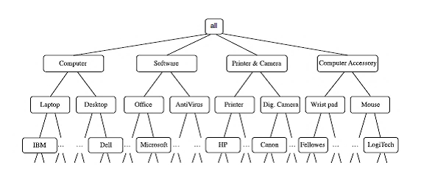

Slide 19
Using uniform minimum support for all levels:
When a uniform minimum support threshold is used, the search procedure is simplified.
The method is also simple, in that users are required to specify only one minimum support threshold.
The same minimum support threshold is used when mining at each level of abstraction.
For example, a minimum support threshold of 5% is used throughout.
(e.g. for mining from “computer” down to “laptop computer”).
Both “computer” and “laptop computer” are found to be frequent, while “desktop computer” is not.

Slide 20
Drawbacks of uniform min support count :
1. If the minimum support threshold is set too high, it could miss some meaningful associations occurring at low abstraction levels.
2. If the threshold is set too low, it may generate many uninteresting associations occurring at high abstraction levels

Slide 21
Using reduced minimum support at lower levels (referred to as reduced support):
Each level of abstraction has its own minimum support threshold. The deeper the level of abstraction, the smaller the corresponding threshold is.

Slide 22
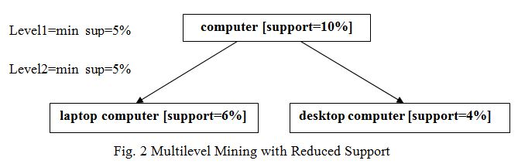
uniform minimum support for all levels
Using reduced minimum support at lower levels (referred to as reduced support)

Slide 23
Association Mining to Correlation Analysis
A correlation measure can be used to augment the support-confidence framework for association rules. This leads to correlation rules of the form
  A=>B [support, confidence, correlation]
That is, a correlation rule is measured not only by its support and confidence but also by the correlation between itemsets A and B. There are many different correlation measures from which to choose.

Slide 24
Association Mining to Correlation Analysis
Correlation may be :
  Positive
  Negative
  No Relation
  In Data mining, Association Mining to Correlation Analysis depend on lift.

Slide 25

Association Mining to Correlation Analysis
The lift between the occurrence of A and B can be measured by computing
If the lift(A,B) is less than 1, then the occurrence of A is negatively correlated with the occurrence of B.
If the resulting value is greater than 1, then A and B are positively correlated, meaning that the occurrence of one implies the occurrence of the other.
If the resulting value is equal to 1, then A and B are independent and there is no correlation between them.

